Slide 1
Scala
Deepak Yadav

Slide 2


Slide 3
http://deepakyadav.org/scala_intro.pptx

Slide 4
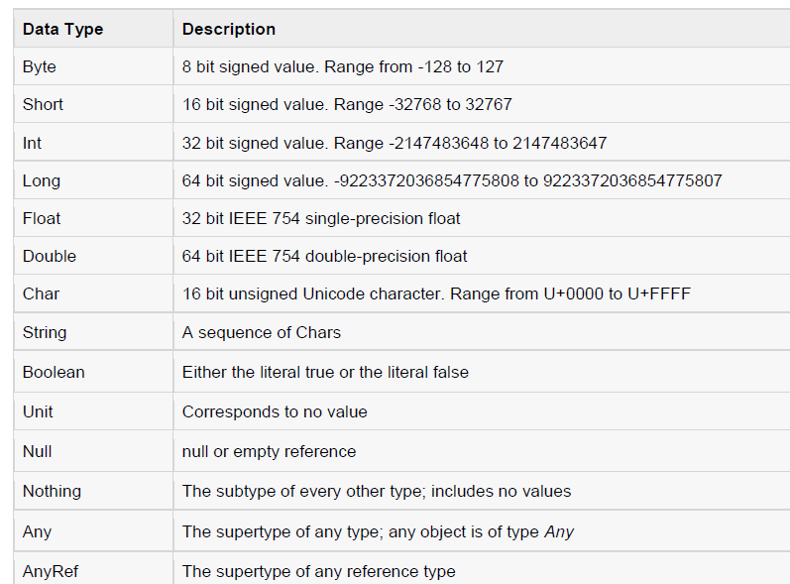

Slide 5
Variable
With initial values
val or val VariableName : DataType [= Initial Value]
Without Initial values
var myVar :Int;
val myVal :String;

Slide 6
• Arithmetic Operators
• Relational Operators
• Logical Operators
• Bitwise Operators
• Assignment Operators

Slide 7
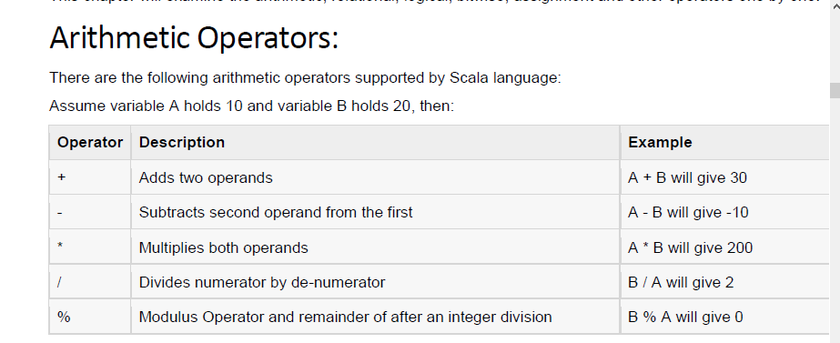

Slide 8
object Test {
def main(args: Array[String]) {
var a = 10;
var b = 20;
var c = 25;
var d = 25;
println("a + b = " + (a + b) );
println("a - b = " + (a - b) );
println("a * b = " + (a * b) );
println("b / a = " + (b / a) );
println("b % a = " + (b % a) );
println("c % a = " + (c % a) );
} }

Slide 9
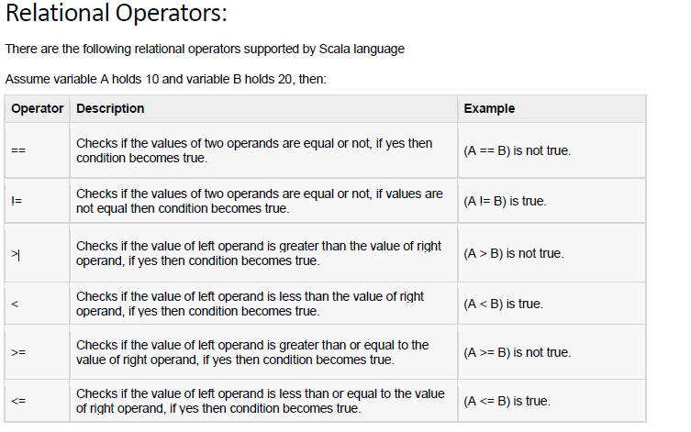

Slide 10
object Test {
def main(args: Array[String]) {
var a = 10;
var b = 20;
println("a == b = " + (a == b) );
println("a != b = " + (a != b) );
println("a > b = " + (a > b) );
println("a < b = " + (a < b) );
println("b >= a = " + (b >= a) );
println("b <= a = " + (b <= a) );
} }

Slide 11
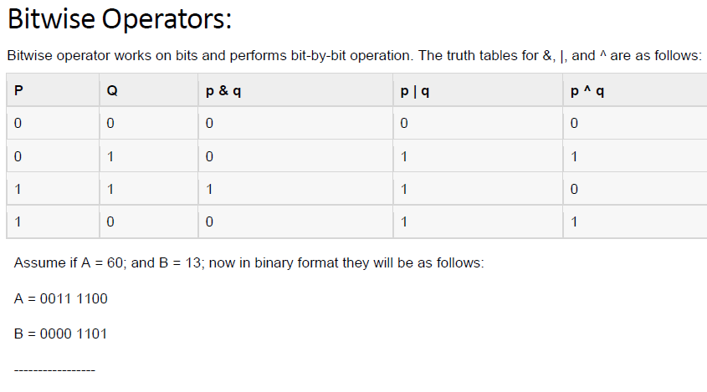

Slide 12
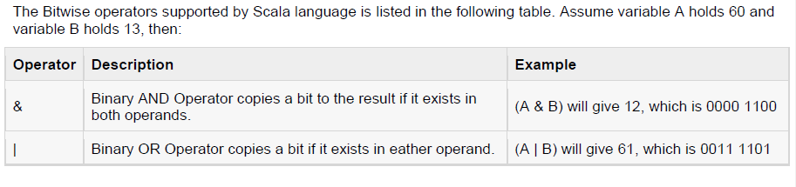

Slide 13
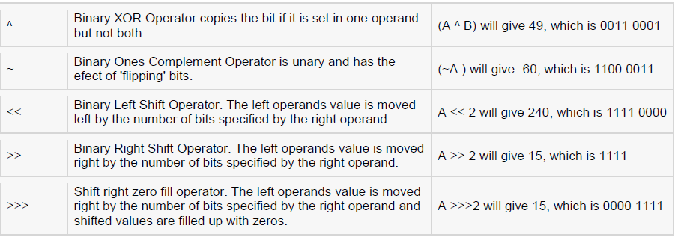

Slide 14
object Test {
def main(args: Array[String])
{
var a = 60; /* 60 = 0011 1100 */
var b = 13; /* 13 = 0000 1101 */
var c = 0; c = a & b; /* 12 = 0000 1100 */
println("a & b = " + c );
c = a | b; /* 61 = 0011 1101 */
println("a | b = " + c );

Slide 15
c = a ^ b; /* 49 = 0011 0001 */
println("a ^ b = " + c );
c = ~a; /* -61 = 1100 0011 */
println("~a = " + c );
c = a << 2; /* 240 = 1111 0000 */
println("a << 2 = " + c );
c = a >> 2; /* 215 = 1111 */
println("a >> 2 = " + c );
c = a >>> 2; /* 215 = 0000 1111 */
println("a >>> 2 = " + c );
}
}

Slide 16
output
C:/>scalac Test.scala
C:/>scala Test
a == b = false
a != b = true
a > b = false
a < b = true
b >= a = true
b <= a = false

Slide 17
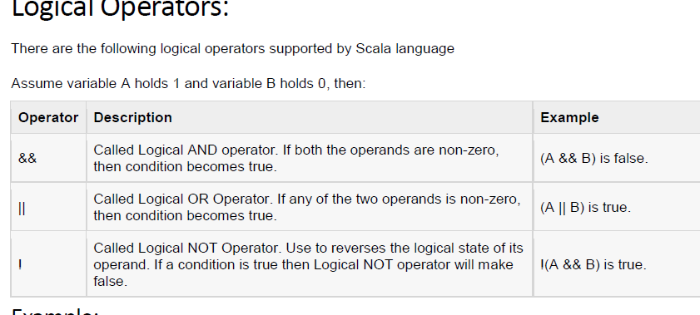

Slide 18
object Test {
def main(args: Array[String]) {
var a = true;
var b = false;
println("a && b = " + (a&&b) );
println("a || b = " + (a||b) );
println("!(a && b) = " + !(a && b) );
} }

Slide 19
output
a && b = false
a || b = true
!(a && b) = true

Slide 20
Converting Between Numeric Types (Casting)
scala> val b = a.to[Tab]
toByte toChar toDouble toFloat toInt toLong toShort toString
scala> 19.45.toInt
res0: Int = 19
scala> 19.toFloat
res1: Float = 19.0
scala> 19.toDouble
res2: Double = 19.0
scala> 19.toLong
res3: Long = 19
scala> val b = a.toFloat
b: Float = 1945.0

Slide 21
Overriding the Default Numeric Type
Scala automatically assigns types to numeric values when you assign them, and you need to override the default type it assigns as you create a numeric field.
If you assign 1 to a variable, Scala assigns it the type Int:
scala> val a = 1
a: Int = 1
The following examples show one way to override simple numeric types:
scala> val a = 1d
a: Double = 1.0
scala> val a = 1f
a: Float = 1.0
scala> val a = 1000L
a: Long = 1000

Slide 22
Another approach is to annotate the variable with a type, like this:
scala> val a = 0: Byte
a: Byte = 0
scala> val a = 0: Int
a: Int = 0
scala> val a = 0: Short
a: Short = 0
scala> val a = 0: Double
a: Double = 0.0
scala> val a = 0: Float
a: Float = 0.0

Slide 23
The for Loop with Ranges
for( var x <- Range ){
statement(s);
}
Here, the Range could be a range of numbers and that is represented as i to j or sometime like i until j.
The left-arrow <- operator is called a generator, so named because it's generating individual values from a range.

Slide 24
object Test {
def main(args: Array[String]) {
var a = 0;
// for loop execution with a range
for( a <- 1 to 10){
println( "Value of a: " + a );
}
}
}

Slide 25
output
value of a: 1
value of a: 2
value of a: 3
value of a: 4
value of a: 5
value of a: 6
value of a: 7
value of a: 8
value of a: 9
value of a: 10

Slide 26
Multiple range
object Test {
def main(args: Array[String]) {
var a = 0; var b = 0;
// for loop execution with a range
for( a <- 1 to 3; b <- 1 to 3){
println( "Value of a: " + a );
println( "Value of b: " + b );
println(s “a= $a, b=$b”);
}
}
}

Slide 27
output
Value of a: 1
Value of b: 1
Value of a: 1
Value of b: 2
Value of a: 1
Value of b: 3
Value of a: 2
Value of b: 1
Value of a: 2
Value of b: 2
Value of a: 2
Value of b: 3
Value of a: 3
Value of b: 1
Value of a: 3
Value of b: 2
Value of a: 3
Value of b: 3

Slide 28
The for loop with filters
Scala's for loop allows to filter out some elements using one or more if statement(s). Following is the syntax of for loop along with filters.
for( var x <- List
if condition1; if condition2...
){
statement(s);
}

Slide 29
example
object Test {
def main(args: Array[String]) {
var a = 0;
val numList = List(1,2,3,4,5,6,7,8,9,10);
// for loop execution with multiple filters
for( a <- numList
if a != 3; if a < 8 ){
println( "Value of a: " + a );
}
}
}

Slide 30
output
value of a: 1
value of a: 2
value of a: 4
value of a: 5
value of a: 6
value of a: 7
// 3 is left
// 8 to 10 are left

Slide 31
The for loop with yield
You can store return values from a for loop in a variable or can return through a function. To do so, you prefix the body of the for expression by the keyword yield as follows:
var retVal = for{ var x <- List
if condition1; if condition2...
}yield x
Note the curly braces have been used to keep the variables and conditions and retVal is a variable where all the values of x will be stored in the form of collection.

Slide 32
object Test {
def main(args: Array[String]) {
var a = 0;
val numList = List(1,2,3,4,5,6,7,8,9,10);
// for loop execution with a yield
var retVal = for{ a <- numList
if a != 3; if a < 8
}yield a
// Now print returned values using another loop.
for( a <- retVal){
println( "Value of a: " + a ); } } }

Slide 33
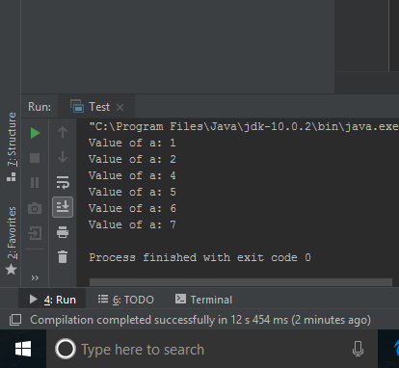

Slide 34
for (i <- 1 to 10 by 2){
println(i)
}
1
3
5
7
9
f

Slide 35
for (i <- 10 to 1 by -1){
println(i)
}
10
9
8
7
6
5
4
3
2
1

Slide 36
object ExampleForLoop {
def main(args: Array[String]) {
val a = Array("apple", "banana", "orange")
for (e <- a) println(e)
}
}
output
apple
banana
orange

Slide 37
A while loop statement is executed repeatedly until the condition is false.
while(condition) {
statement
}
object ExampleWhileLoop{
def main(args:Array[String]) {
var id = 5 ;
while(id < 15 ) {
println(" Id is:" +id);
id = id + 1;
}
}
}

Slide 38
output
Id is:5
Id is:6
Id is:7
Id is:8
Id is:9
Id is:10
Id is:11
Id is:12
Id is:13
Id is:14

Slide 39
The do while loop statements executes at least once and then the while loop is executed till the condition is true.
do{
statements;
}
while( condition );

Slide 40
object ExampleDoWhile {
def main(args:Array[String]) {
var id = 4;
do {
println(" Id is:"+id);
id = id + 1
}while(id < 10)
}
}

Slide 41
output
Id is:4
Id is:5
Id is:6
Id is:7
Id is:8
Id is:9

Slide 42
Collections
List
Array (and ArrayBuffer)
Map
Set

Slide 43
List
The Scala List class is immutable, so its size as well as the elements it refers to can’t change.
It’s implemented as a linked list, and is generally thought of in terms of its head, tail, and isEmpty methods.

Slide 44
There are many ways to create and initially populate a List:
// 1
scala> val list = 1 :: 2 :: 3 :: Nil
list: List[Int] = List(1, 2, 3)
// 2
scala> val list = List(1, 2, 3)
x: List[Int] = List(1, 2, 3)
// 3a
scala> val x = List(1, 2.0, 33D, 4000L)
x: List[Double] = List(1.0, 2.0, 33.0, 4000.0)

Slide 45
// 3b
scala> val x = List[Number](1, 2.0, 33D, 4000L)
x: List[java.lang.Number] = List(1, 2.0, 33.0, 4000)
// 4
scala> val x = List.range(1, 10)
x: List[Int] = List(1, 2, 3, 4, 5, 6, 7, 8, 9)
scala> val x = List.range(0, 10, 2)
x: List[Int] = List(0, 2, 4, 6, 8)
// 5
scala> val x = List.fill(3)("foo")
x: List[String] = List(foo, foo, foo)

Slide 46
// 6
scala> val x = List.tabulate(5)(n => n * n)
x: List[Int] = List(0, 1, 4, 9, 16)
// 7
scala> val x = collection.mutable.ListBuffer(1, 2, 3).toList
x: List[Int] = List(1, 2, 3)
// 8
scala> "foo".toList
res0: List[Char] = List(f, o, o)

Slide 47
Although you can’t modify the elements in a List, you can create a new List from an existing one, typically prepending items to the original list with the :: method:
scala> val x = List(2)
x: List[Int] = List(2)
scala> val y = 1 :: x
y: List[Int] = List(1, 2)
scala> val z = 0 :: y
z: List[Int] = List(0, 1, 2)

Slide 48
Creating a Mutable List
Use a ListBuffer, and convert the ListBuffer to a List when needed.
import scala.collection.mutable.ListBuffer
var fruits = new ListBuffer[String]()
// add one element at a time to the ListBuffer
fruits += "Apple"
fruits += "Banana"
fruits += "Orange"

Slide 49
// add multiple elements
fruits += ("Strawberry", "Kiwi", "Pineapple")
// remove one element
fruits -= "Apple"
// remove multiple elements
fruits -= ("Banana", "Orange")
// remove multiple elements specified by another sequence
fruits --= Seq("Kiwi", "Pineapple")
// convert the ListBuffer to a List when you need to
val fruitsList = fruits.toList

Slide 50
Print the elements of ListBuffer
for(f <- fruitsList) print(fruitsList)
Another way
for(i <- 0 until fruitsList.size) print(fruitsList(i))

Slide 51
OUTPUT
import scala.collection.mutable.ListBuffer
fruits: scala.collection.mutable.ListBuffer[String] = ListBuffer()
res0: scala.collection.mutable.ListBuffer[String] = ListBuffer(Apple)
res1: scala.collection.mutable.ListBuffer[String] = ListBuffer(Apple, Banana)
res2: scala.collection.mutable.ListBuffer[String] = ListBuffer(Apple, Banana, Orange)
res3: scala.collection.mutable.ListBuffer[String] = ListBuffer(Apple, Banana, Orange, Strawberry, Kiwi, Pineapple)
res4: scala.collection.mutable.ListBuffer[String] = ListBuffer(Banana, Orange, Strawberry, Kiwi, Pineapple)
res5: scala.collection.mutable.ListBuffer[String] = ListBuffer(Strawberry, Kiwi, Pineapple)
res6: scala.collection.mutable.ListBuffer[String] = ListBuffer(Strawberry)
fruitsList: List[String] = List(Strawberry)
List(Strawberry)res7: Unit = ()

Slide 52
Comparision
fruitsList == List("Strawberry")
Output
res8: Boolean = true

Slide 53
Operations on list
head : returns the first element of a list
tail : returns a list consisting of all elements except the first
isEmpty: returns true if the list is empty

Slide 54
Other operations
val noList = List(1,2,3,4,5,6,7,8,9)
noList.reverse
//OUTPUT res0: List[Int] = List(9, 8, 7, 6, 5, 4, 3, 2, 1)
noList.take(3)
//OUTPUT res1: List[Int] = List(1, 2, 3)
noList.drop(3)
//OUTPUT res2: List[Int] = List(4, 5, 6, 7, 8, 9)

Slide 55
noList.contains(7)
//OUTPUT res3: Boolean = true
noList.indexOf(8)
//OUTPUT res4: Int = 7
noList.last
//OUTPUT res5: Int = 9

Slide 56
HEAD /TAIL
noList.head
//OUTPUt res6: Int = 1
noList.tail
//OUTPUT res7: List[Int] = List(2, 3, 4, 5, 6, 7, 8, 9)
noList.tail.tail.head
// res8: Int = 3

Slide 57
noList.tail.tail.tail.head
res9: Int = 4
noList.tail.tail
res10: List[Int] = List(3, 4, 5, 6, 7, 8, 9)
noList.tail(4)
res11: Int = 6

Slide 58
Adding Elements using other List
val noList2 = 0 :: noList
noList2: List[Int] = List(0, 1, 2, 3, 4, 5, 6, 7, 8, 9)

Slide 59
Delete elements from a List or ListBuffer.
A List is immutable, so you can’t delete elements from it, but you can filter out the elements you don’t want while you assign the result to a new variable:
val newList = noList.filter(_ > 2)
newList: List[Int] = List(3, 4, 5, 6, 7, 8, 9)

Slide 60
Another way
Rather than continually assigning the result of operations like this to a new variable, you can declare your variable as a var and reassign the result of the operation back to tself:
var x = List(5, 1, 4, 3, 2)
x = x.filter(_ > 2)
//output
x: List[Int] = List(5, 1, 4, 3, 2)
x: List[Int] = List(5, 4, 3)

Slide 61
Function
A function is a group of statements that together perform a task.
Scala has both functions and methods and we use the terms method and function interchangeably with a minor difference.

Slide 62
A Scala method is a part of a class which has a name, a signature, optionally some annotations, and some bytecode where as a function in Scala is a complete object which can be assigned to a variable.
In other words, a function, which is defined as a member of some object, is called a method.
A function in Scala is a “first-class value”. Like any other value, it may be passed as a parameter or returned as a result.

Slide 63
Function Defination
def functionName ([list of parameters]) : [return type] = {
function body
return [expr]
}
Here, return type could be any valid scala data type and list of parameters will be a list of variables separated by comma and list of parameters and return type are optional.

Slide 64
def addInt( a:Int, b:Int ) : Int = {
var sum:Int = 0
sum = a + b
return sum
}

Slide 65
A function, which does not return anything, can return Unit which is equivalent to void in Java and indicates that function does not return anything.
The functions, which do not return anything in Scala, they are called procedures. Following is the syntax

Slide 66
def printMe( ) : Unit = {
println("Hello, Scala!")
}
Functions without parameters could be called with or without parenthesis viz:
printMe()
printMe

Slide 67
Functions with named argument
def addInt( a:Int, b:Int ) : Int = {
var sum:Int = 0
sum = a + b
println("Value of a : " + a );
println("Value of b : " + b );
return sum
}
addInt(10, 11);
addInt(b=11, a=10)

Slide 68
output
Value of a : 10
Value of b : 11
Value of a : 10
Value of b : 11

Slide 69
Function with Variable Arguments
def printStrings( args:String* ) = {
var i : Int = 0;
for( arg <- args )
{
println("Arg value[" + i + "] = " + arg );
i = i + 1;
}
}
//Here, the type of args inside the printStrings function, which is declared as type "String*" is actually Array[String].

Slide 70
printStrings("Hello", "World", "Bye");
OUTPUT
Arg value[0] = Hello
Arg value[1] = World
Arg value[2] = Bye

Slide 71
Default Parameter Values
def addInt( a:Int=5, b:Int=7 ) : Int = {
var sum:Int = 0
sum = a + b
return sum
}
addInt()

Slide 72
Anonymous Functions
Instead of using named function definitions for these small argument functions, we can formulate them in a shorter way as anonymous functions.
An anonymous function is an expression that evaluates to a function; the function is defined without giving it a name. As an example consider the anonymous square function:
(x: Int) => x * x
The part before the arrow ‘=>’ are the parameters of the function, whereas the part following the ‘=>’ is its body. For instance, here is an anonymous function which multiples its two arguments.
(x: Int, y: Int) => x * y

Slide 73
var mul = (x: Int, y: Int) => x * y
println(mul(10,20))
It is also possible to define functions with no parameter as follows:
var userDir = () => { System.getProperty("user.dir") }
println( userDir )

Slide 74
Higher-Order Functions
Higher-order functions in Scala can do following things.
They can take a function as an argument.
They can return a function as a value.

Slide 75
def intDecorator(x:Int, f: Int => String) = f(x)
The argument f has a function type (Int => String).
So the intDecorator takes a function as a second argument. The type of the function must be Int => String.

Slide 76
intDecorator(5, (y:Int) => "[" + y + "]" )
output
[5]

Slide 77
Maps and Tuples
Maps are collections of key/value pairs.
Scala has a general notation of tuples—aggregates of n objects, not necessarily of the same type.
A pair is simply a tuple with n = 2.
Tuples are useful whenever you need to aggregate two or more values together

Slide 78
Features
Scala has a pleasant syntax for creating, querying, and traversing maps.
You need to choose between mutable and immutable maps.
By default, you get a hash map, but you can also get a tree map.
You can easily convert between Scala and Java maps.
Tuples are useful for aggregating values.

Slide 79
Constructing a Map
val scores = Map("Alice" -> 10, "Bob" -> 3, "Cindy" -> 8)
This constructs an immutable Map[String, Int] whose contents can’t be changed.
If you want a mutable map, use
val scores = scala.collection.mutable.Map("Alice" -> 10, "Bob" -> 3, "Cindy" -> 8)

Slide 80
If you want to start out with a blank map, you have to pick a map implementation and supply type parameters:
val scores = new scala.collection.mutable.HashMap[String, Int]

Slide 81
In Scala, a map is a collection of pairs. A pair is simply a grouping of two values,not necessarily of the same type, such as
("Alice", 10).
The -> operator makes a pair. The value of "Alice" -> 10 is ("Alice", 10)
You could have equally well defined the map as
val scores = Map(("Alice", 10), ("Bob", 3), ("Cindy", 8))
The -> operator is just a little easier on the eyes than the parentheses. It also supports the intuition that a map data structure is a kind of function that maps keys to values. The difference is that a function computes values, and a map just looks them up.

Slide 82
Accessing Map Values
In Scala, the analogy between functions and maps is particularly close because you use the () notation to look up key values.
val alicesScore = scores("Alice")
If the map doesn’t contain a value for the requested key, an exception is thrown. To check whether there is a key with the given value, call the contains method:
val alicesScore = if (scores.contains("Alice")) scores("Alice") else 0

Slide 83
Updating Map Values
In a mutable map, you can update a map value, or add a new one, with a () to the left of an = sign:
scores("Bob") = 10
// Updates the existing value for the key "Bob" (assuming scores is mutable)
scores("Fred") = 7
// Adds a new key/value pair to scores (assuming it is mutable)

Slide 84
Alternatively, you can use the += operation to add multiple associations:
scores += ("Bob" -> 10, "Fred" -> 7)
To remove a key and its associated value, use the -= operator:
scores -= "Alice"

Slide 85
You can’t update an immutable map, but you can do something that’s just as useful—obtain a new map that has the desired update:
val newScores = scores + ("Bob" -> 10, "Fred" -> 7) // New map with update
The newScores map contains the same associations as scores, except that "Bob" has been updated and "Fred" added.
Instead of saving the result as a new value, you can update a var:
var scores = ...
scores = scores + ("Bob" -> 10, "Fred" -> 7)

Slide 86
Similarly, to remove a key from an immutable map, use the minus(-) operator to obtain a new map without the key:
scores = scores - "Alice"

Slide 87
Iterating over Maps
The following amazingly simple loop iterates over all key/value pairs of a map:
for ((k, v) <- map) process k and v

Slide 88
To visit the keys or values, use the keySet and values methods
scores.keySet
// A set such as Set("Bob", "Cindy", "Fred", "Alice")
states.values
or
for (v <- scores.values) println(v)
// Prints 10 8 7 10

Slide 89
Sorted Map
When working with a map, you need to choose an implementation—a hash table or a balanced tree. By default, Scala gives you a hash table. You might want a tree map if you don’t have a good hash function for the keys, or if you need to visit the keys in sorted order. To get an immutable tree map instead of a hash map, use
val scores = scala.collection.immutable.SortedMap("Alice" -> 10,
"Fred" -> 7, "Bob" -> 3, "Cindy" -> 8)
Unfortunately, there is (as of Scala 2.9) no mutable tree map. Your best bet is to adapt a Java TreeMap..

Slide 90
LinkedHashMap
If you want to visit the keys in insertion order, use a LinkedHashMap. For example,
val months = scala.collection.mutable.LinkedHashMap("January" -> 1,
"February" -> 2, "March" -> 3, "April" -> 4, "May" -> 5, ...)

Slide 91
Interoperating with Java
If you get a Java map from calling a Java method, you may want to convert it to a Scala map so that you can use the pleasant Scala map API. This is also useful if you want to work with a mutable tree map, which Scala doesn’t provide. Simply add an import statement:
import scala.collection.JavaConversions.mapAsScalaMap
Then trigger the conversion by specifying the Scala map type:
val scores: scala.collection.mutable.Map[String, Int] = new java.util.TreeMap[String, Int]

Slide 92
Code
val scores = scala.collection.mutable.Map("Alice" -> 10, "Bob" -> 3, "Cindy" -> 8)
println(scores)
scores("Bob") = 10
println(scores)

Slide 93
val newScores = scores + ("Bob" -> 100, "Fred" -> 7)
for (v <- newScores.values) println(v)
//val ns1 = scores + newScores
//ns1.keySet
println(newScores)

Slide 94
Tuples
Maps are collections of key/value pairs. Pairs are the simplest case of tuples—aggregates of values of different types. A tuple value is formed by enclosing individual values in parentheses. For example,
(1, 3.14, "Fred") is a tuple of type
Tuple3[Int, Double, java.lang.String] which is also written as
(Int, Double, java.lang.String)

Slide 95
If you have a tuple, say,
val t = (1, 3.14, "Fred")
then you can access its components with the methods _1, _2, _3, for example:
val second = t._2 // Sets second to 3.14
Unlike array or string positions, the component positions of a tuple start with 1, not 0.

Slide 96
You can write
t._2 as t _2
(with a space instead of a period),
but not t_2.
Tuples are useful for functions that return more than one value.

Slide 97
Zipping
One reason for using tuples is to bundle together values so that they can be processed together. This is commonly done with the zip method. For example, the code
val symbols = Array("<", "-", ">")
val counts = Array(2, 10, 2)
val pairs = symbols.zip(counts)
yields an array of pairs
Array(("<", 2), ("-", 10), (">", 2))
The pairs can then be processed together:
for ((s, n) <- pairs) print(s * n)
// Prints <<---------->>

Slide 99
Classes and Objects
class Counter {
private var value = 0 // You must initialize the field
def increment() { value += 1} // Methods are public by default
def current() = value
}
In Scala, a class is not declared as public. A Scala source file can contain multiple classes, and all of them have public visibility.

Slide 100
To use this class, you construct objects and invoke methods in the usual way:
val myCounter = new Counter // Or new Counter()
myCounter.increment()
println(myCounter.current)

Slide 101
You can call a parameterless method (such as current) with or without parentheses:
myCounter.current // OK
myCounter.current() // Also OK

Slide 102
Which form should you use?
It is considered good style to use () for a mutator method (a method that changes the object state), and to drop the () for an accessor method (a method that does not change the object state).

Slide 103
That’s what we did in our example:
myCounter.increment() // Use () with mutator
println(myCounter.current) // Don’t use () with accessor
You can enforce this style by declaring current without ():
class Counter {
... def current = value // No () in definition
}
Now the class user must use myCounter.current, without parentheses.

Slide 104
Getter and Setter
Scala provides getter and setter methods for every field. Here, we define a public field:
class Person {
var age = 0
}

Slide 105
Scala generates a class for the JVM with a private age field and getter and setter methods. These methods are public because we did not declare age as private. (For a private field, the getter and setter methods are private.) In Scala, the getter and setter methods are called age and age_=. For example,
println(sunny.age) // Calls the method sunny.age()
sunny.age = 21 // Calls sunny.age_=(21)

Slide 106
Check … Check…
Compile the Person class and then look at the bytecode with javap:
Compiled from "Person.scala"
public class Person extends java.lang.Object implements scala.ScalaObject{
private int age;
public int age();
public void age_$eq(int);
public Person();
}

Slide 107
As you can see, the compiler created methods age and age_$eq. (The = symbol is translated to $eq because the JVM does not allow an = in a method name.)

Slide 108
At any time, you can redefine the getter and setter methods yourself. For example,
class Person {
private var privateAge = 0 // Make private and rename
def age = privateAge
def age_=(newValue: Int) {
if (newValue > privateAge) privateAge = newValue; // Can’t get younger
}
}

Slide 109
The user of your class still accesses sunny.age, but now Sunny can’t get younger:
val sunny = new Person
sunny.age = 30
sunny.age = 21
println(sunny.age) // 30

Slide 110
It may sound scary that Scala generates getter and setter methods for every field. But you have some control over this process.
If the field is private, the getter and setter are private.
If the field is a val, only a getter is generated.
If you don’t want any getter or setter, declare the field as private[this]

Slide 111
Properties with Only Getters / ReadOnly
Sometimes you want a read-only property with a getter but no setter. If the value of the property never changes after the object has been constructed, use a val field:
class Message {
val timeStamp = new java.util.Date
...
}
Scala makes a private final field and a getter method, but no setter.

Slide 112
We have four choices for implementing properties:
1. var foo: Scala synthesizes a getter and a setter.
2. val foo: Scala synthesizes a getter.
3. You define methods foo and foo_=.
4. You define a method foo.
In Scala, you cannot have a write-only property (that is, a property with a setter and no getter).

Slide 113
Object-Private Fields
In Scala , a method can access the private fields of all objects of its class. For example,
class Counter {
private var value = 0
def increment() { value += 1 }
def isLess(other : Counter) = value < other.value
// Can access private field of other object
}
Accessing other.value is legal because other is also a Counter object.

Slide 114
Scala allows an even more severe access restriction, with the private[this] qualifier:
private[this] var value = 0 // Accessing someObject.value is not allowed
Now, the methods of the Counter class can only access the value field of the current object, not of other objects of type Counter. This access is sometimes called object-private, and it is common in some OO languages, such as SmallTalk.
With a class-private field, Scala generates private getter and setter methods. However, for an object-private field, no getters and setters are generated at all.

Slide 115
Auxiliary Constructors
As in Java or C++, a Scala class can have as many constructors as you like. However, a Scala class has one constructor that is more important than all the others, called the primary constructor. In addition, a class may have any number of auxiliary constructors.
We discuss auxiliary constructors first because they are easier to understand. They are very similar to constructors in Java or C++, with just two differences.
1. The auxiliary constructors are called this. (In Java or C++, constructors have the same name as the class—which is not so convenient if you rename the class.)
2. Each auxiliary constructor must start with a call to a previously defined auxiliary constructor or the primary constructor.

Slide 116
Here is a class with two auxiliary constructors.
class Person {
private var name = ""
private var age = 0
def this(name: String) { // An auxiliary constructor
this() // Calls primary constructor
this.name = name
}
def this(name: String, age: Int) { // Another auxiliary constructor
this(name) // Calls previous auxiliary constructor
this.age = age
}
}

Slide 117
It is sufficient to know that a class for which you don’t define a primary constructor has a primary constructor with no arguments.
You can construct objects of this class in three ways:
val p1 = new Person // Primary constructor
val p2 = new Person("Fred") // First auxiliary constructor
val p3 = new Person("Fred", 42) // Second auxiliary constructor

Slide 118
The Primary Constructor
In Scala, every class has a primary constructor. The primary constructor is not defined with a this method. Instead, it is interwoven with the class definition.
1. The parameters of the primary constructor are placed immediately after the class name.
class Person(val name: String, val age: Int) {
// Parameters of primary constructor in (...)
...
}

Slide 119
Parameters of the primary constructor turn into fields that are initialized with the construction parameters. In our example, name and age become fields of the Person class. A constructor call such as new Person(“Sunny", 42) sets the name and age fields.

Slide 120
2. The primary constructor executes all statements in the class definition. For example, in the following class
class Person(val name: String, val age: Int) {
println("Just constructed another person")
def description = name + " is " + age + " years old"
}
the println statement is a part of the primary constructor. It is executed whenever an object is constructed.

Slide 121
This is useful when you need to configure a field during construction. For example:
class Person {
private val props = new Properties
props.load(new FileReader("myprog.properties"))
// The statement above is a part of the primary constructor
...
}

Slide 122
If there are no parameters after the class name, then the class has a primary constructor with no parameters. That constructor simply executes all statements in the body of the class.
You can often eliminate auxiliary constructors by using default arguments in the primary constructor. For example:
class Person(val name: String = "", val age: Int = 0)

Slide 123
Inheritance
class Employee{
var salary:Float = 10000
}
class Programmer extends Employee{
var bonus:Int = 5000
println("Salary = "+salary)
println("Bonus = "+bonus)
}

Slide 124
Method Overloading
When a subclass has the same name method as defined in the parent class, it is known as method overriding. When subclass wants to provide a specific implementation for the method defined in the parent class, it overrides method from parent class.
In scala, you must use either override keyword or override annotation to override methods from parent class.

Slide 125
Code
class Vehicle{
def run(){
println("vehicle is running")
}
}
class Bike extends Vehicle{
override def run(){
println("Bike is running")
}
}

Slide 126
object MainObject{
def main(args:Array[String]){
var b = new Bike()
b.run()
}
}

Slide 127
Field Override
class Vehicle{
val speed:Int = 60
}
class Bike extends Vehicle{
override val speed:Int = 100 // Override keyword
def show(){
println(speed)
}
}

Slide 128
Final
Final is a keyword, which is used to prevent inheritance of super class members into derived class. You can declare final variables, methods and classes also.
lass Vehicle{
final val speed:Int = 60
}
class Bike extends Vehicle{
override val speed:Int = 100
def show(){
println(speed)
}
}

Slide 129
output
Error - value speed cannot override final member

Slide 130
Abstract Class
A class which is declared with abstract keyword is known as abstract class. An abstract class can have abstract methods and non-abstract methods as well. Abstract class is used to achieve abstraction. Abstraction is a process in which we hide complex implementation details and show only functionality to the user.
In scala, we can achieve abstraction by using abstract class and trait. We have discussed about these in detail here.

Slide 131
abstract class Bike{
def run()
}
class Hero extends Bike{
def run(){
println("running fine...")
}
}

Slide 132
Traits
In scala, trait is a collection of abstract and non-abstract methods. You can create trait that can have all abstract methods or some abstract and some non-abstract methods.
A variable that is declared either by using val or var keyword in a trait get internally implemented in the class that implements the trait. Any variable which is declared by using val or var but not initialized is considered abstract.
Traits are compiled into Java interfaces with corresponding implementation classes that hold any methods implemented in the traits

Slide 133
trait Printable{
def print()
}
class A4 extends Printable{
def print(){
println("Hello")
}
}

Slide 134
Mixin / Within
trait Print{
def print()
}
abstract class PrintA4{
def printA4()
}
class A6 extends Print with PrintA4{
def print(){ // Trait print
println("print sheet")
}
def printA4(){ // Abstract class printA4
println("Print A4 Sheet")
}
}

Slide 135
Exception
Exception handling is a mechanism which is used to handle abnormal conditions. You can also avoid termination of your program unexpectedly.
Scala provides try and catch block to handle exception. The try block is used to enclose suspect code. The catch block is used to handle exception occurred in try block. You can have any number of try catch block in your program according to need.

Slide 136
Code - Try/ Catch
class ExceptionExample{
def divide(a:Int, b:Int) = {
try{
a/b
}catch{
case e: ArithmeticException => println(e)
}
println("Rest of the code is executing...")
}
}

Slide 137
object MainObject{
def main(args:Array[String]){
var e = new ExceptionExample()
e.divide(100,0)
}
}

Slide 138
Code - finally
The finally block is used to release resources during exception. Resources may be file, network connection, database connection etc. the finally block executes guaranteed. The following program illustrate the use of finally block.
class ExceptionExample{
def divide(a:Int, b:Int) = {
try{
Somecode.........
}catch{
somecode
}
finally{
println("Finaly block always executes")
}
println("Rest of the code is executing...")
}
}

Slide 139
Throw
You can throw exception explicitly in you code. Scala provides throw keyword to throw exception. The throw keyword mainly used to throw custom exception.
class ExceptionExample2{
def validate(age:Int)={
if(age<18)
throw new ArithmeticException("You are not eligible")
else println("You are eligible")
}
}

Slide 140
Files
scala.io.Source class and its companion object offer some nice simplifications compared to Java.
import scala.io.Source
val filename = "fileopen.scala"
for (line <- Source.fromFile(filename).getLines) {
println(line)
}

Slide 141
The fromFile method returns a BufferedSource, and its getLines method treats “any of \r\n, \r, or \n as a line separator (longest match),” so each element in the sequence is a line from the file.

Slide 142
Properly closing the file
To properly close the file, get a reference to the BufferedSource when opening the file, and manually close it when you’re finished with the file:
val bufferedSource = Source.fromFile("example.txt")
for (line <- bufferedSource.getLines) {
println(line.toUpperCase)
}
bufferedSource.close

Slide 143
Writing Text Files
Scala doesn’t offer any special file writing capability, so fall back and use the Java PrintWriter or FileWriter approaches:
// PrintWriter
import java.io._
val pw = new PrintWriter(new File("hello.txt" ))
pw.write("Hello, world")
pw.close
// FileWriter
val file = new File(canonicalFilename)
val bw = new BufferedWriter(new FileWriter(file))
bw.write(text)
bw.close()

Slide 144
Reading and Writing Binary Files
Scala doesn’t offer any special conveniences for reading or writing binary files, so use the Java FileInputStream and FileOutputStream classes.

Slide 145
import java.io._
object CopyBytes extends App {
var in = None: Option[FileInputStream]
var out = None: Option[FileOutputStream]
try {
in = Some(new FileInputStream("/tmp/Test.class"))
out = Some(new FileOutputStream("/tmp/Test.class.copy"))
var c = 0
while ({c = in.get.read; c != −1}) {
out.get.write(c)
}
} catch {
case e: IOException => e.printStackTrace
} finally {
println("entered finally ...")
if (in.isDefined) in.get.close
if (out.isDefined) out.get.close
}
}

